Slide 1
What is a Multi-way tree?
A multi-way (or m-way) search tree of order m is a tree in which
  Each node has at-most m subtrees, where the subtrees may be empty.
  Each node consists of at least 1 and at most m-1 distinct keys
  The keys in each node are sorted.
k₁
k₂
k₃
. . .
k_{m-2}
k_{m-1}
T₀
T₁
T₂
T_{m-2}
T_{m-1}
key < k₁
k₁ < key < k₂
k₂ < key < k₃
k_{m-2} < key < k_{m-1}
key > k_{m-1}
The keys and subtrees of a non-leaf node are ordered as:
T₀, k₁, T₁, k₂, T₂, . . . , k_{m-1}, T_{m-1} such that:
  All keys in subtree T0 are less than k1.
  All keys in subtree T_{i} , 1 <= i <= m - 2, are greater than k_{i} but less than k_{i+1}.
  All keys in subtree T_{m-1} are greater than k_{m-1}

Slide 2
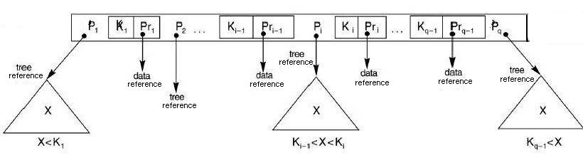
The node structure of a Multi-way tree
Note:
  Corresponding to each key there is a data reference that refers to the data record for that key in secondary memory.
  In our representations we will omit the data references.
  The literature contains other node representations that we will not discuss.

Slide 3
4000 keys, n=5
At least 4000/(5-1) nodes (pages)
  1st level (root): 1 node, 4 keys, 5 sub-trees +
  2nd level: 5 nodes, 20 keys, 25 sub-trees +
  3rd level: 25 nodes, 100 keys, 125 sub-trees +
  4th level: 125 nodes, 500 keys,525 sub-trees +
  5th level: 525 nodes, 2100 keys, 2625 sub-tress +
  6th level: 2625 nodes, 10500 keys, ….
  tree height = 6 (including root)
E.G.M. Petrakis
B-trees

Slide 4
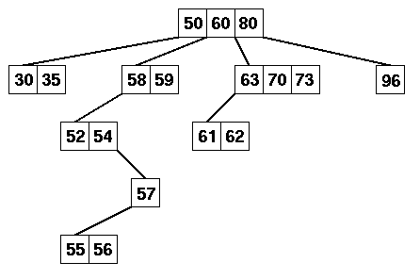
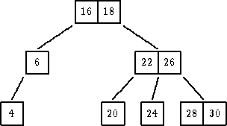
Examples of Multi-way Trees
Note: In a multiway tree:
  The leaf nodes need not be at the same level.
  A non-leaf node with n keys may contain less than n + 1 non-empty subtrees.

Slide 5
Operations on MSTs
Search: returns pointer to node containing the key and position of key in the node
Insert new key if not already in the tree
Delete existing key
E.G.M. Petrakis
B-trees

Slide 6
Insertions
Search & insert key it if not there
  the tree grows at the leafs => the tree becomes imbalanced => not equal number of disk accesses for every key
  the shape of the tree depends on the insertion sequence
  low storage utilization, many non-full nodes
E.G.M. Petrakis
B-trees

Slide 7
insert: 70 75 82 77 71 73 84 86 87 85
70 75 82
n = 4
max 3 keys/node
B-trees

Slide 8
70 75 82
n = 4
max 3 keys/node
70 75 82
77
E.G.M. Petrakis
B-trees

Slide 9
insert: 70 75 82 77 71 73 84 86 87 85
70 75 82
n = 4
max 3 keys/node
70 75 82
77
71 73
E.G.M. Petrakis
B-trees

Slide 10
insert: 70 75 82 77 71 73 84 86 87 85
70 75 82
n = 4
max 3 keys/node
70 75 82
77
71 73
84 86 87
E.G.M. Petrakis
B-trees

Slide 11
insert: 70 75 82 77 71 73 84 86 87 85
70 75 82
n = 4
max 3 keys/node
70 75 82
77
71 73
84 86 87
85
E.G.M. Petrakis
B-trees

Slide 12
MST Deletions
Find and delete a key from a node
  free the node if empty
If the key has right or/and left sub-trees => find its successor or predecessor
  min value of right subtree or max value of left subtree
put this in the position of the key and delete the successor or predecessor
The tree becomes imbalanced
E.G.M. Petrakis
B-trees

Slide 13
n=4
60 180 300
30 50
150 170
220 280
173 178
187 202
153 162
delete 150, 180
E.G.M. Petrakis
B-trees

Slide 14
n=4
60 180 300
30 50
153 170
220 280
173 178
187 202
162
delete 150, 180
E.G.M. Petrakis
B-trees

Slide 15
n=4
60 187 300
30 50
153 170
220 280
173 178
202
162
delete 150, 180
E.G.M. Petrakis
B-trees

Slide 16
What is a B-Tree?
A B-tree of order m (or branching factor m), where m > 2, is either an empty tree or a multiway search tree with the following properties:
  The root is either a leaf or it has at least two non-empty subtrees and at most m non-empty subtrees.
  Each non-leaf node, other than the root, has at least ⎡m/2⎤ non-empty subtrees and at most m non-empty subtrees. (Note: ⎡x⎤ is the lowest integer > x ).
  The number of keys in each non-leaf node is one less than the number of non-empty subtrees for that node.
  All leaf nodes are at the same level; that is the tree is perfectly balanced.

Slide 17
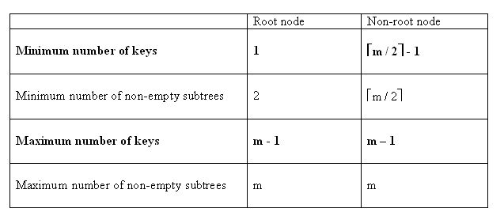
What is a B-tree? (cont’d)
For a non-empty B-tree of order m:
This may be zero, if the node is a leaf as well
These will be zero if the node is a leaf as well

Slide 18
Insertion in B-Trees
OVERFLOW CONDITION:
A root-node or a non-root node of a B-tree of order m overflows if, after a key insertion, it contains m keys.
Insertion algorithm:
If a node overflows, split it into two, propagate the "middle" key to the parent of the node. If the parent overflows the process propagates upward. If the node has no parent, create a new root node.
Note: Insertion of a key always starts at a leaf node.

Slide 19
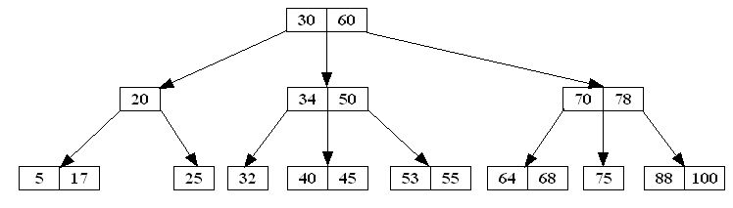
Deletion in B-Tree
Like insertion, deletion must be on a leaf node. If the key to be deleted is not in a leaf, swap it with either its successor or predecessor (each will be in a leaf).
The successor of a key k is the smallest key greater than k.
The predecessor of a key k is the largest key smaller than k.
IN A B-TREE THE SUCCESSOR AND PREDECESSOR, IF ANY, OF ANY KEY IS IN A LEAF NODE
Example: Consider the following B-tree of order 3:
key | predecessor | successor
20 | 17 | 25
30 | 25 | 32
34 | 32 | 40
50 | 45 | 53
60 | 55 | 64
70 | 68 | 75
78 | 75 | 88

Slide 20
Deletion in B-Tree
UNDERFLOW CONDITION
A non-root node of a B-tree of order m underflows if, after a key deletion, it contains ⎡m / 2⎤ - 2 keys
The root node does not underflow. If it contains only one key and this key is deleted, the tree becomes empty.

Slide 21
Deletion in B-Tree
Deletion algorithm:
If a node underflows, rotate the appropriate key from the adjacent right- or left-sibling if the sibling contains at least ⎡m / 2⎤ keys; otherwise perform a merging.
A key rotation must always be attempted before a merging
There are five deletion cases:
  1. The leaf does not underflow.
  2. The leaf underflows and the adjacent right sibling has at least ⎡m / 2 ⎤ keys.
  perform a left key-rotation
  3. The leaf underflows and the adjacent left sibling has at least ⎡m / 2 ⎤ keys.
  perform a right key-rotation
  4. The leaf underflows and each of the adjacent right sibling and the adjacent left sibling has at least ⎡m / 2 ⎤ keys.
  perform either a left or a right key-rotation
  5. The leaf underflows and each adjacent sibling has ⎡m / 2⎤ - 1 keys.
  perform a merging

Slide 22
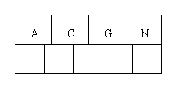
B Trees
Insert the following letters into what is originally an empty B-tree of order 5:
C N G A H E K Q M F W L T Z D P R X Y S
Order 5 means that a node can have a maximum of 5 children and 4 keys.
All nodes other than the root must have a minimum of 2 keys.
The first 4 letters get inserted into the same node, resulting in this picture:

Slide 23

B Trees
C N G A H E K Q M F W L T Z D P R X Y S
insert the H - no room in this node,

Slide 24
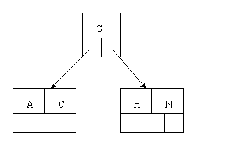
B Trees
C N G A H E K Q M F W L T Z D P R X Y S
insert the H - no room in this node,
so split it into 2 nodes, moving the median item G up into a new root node.

Slide 25
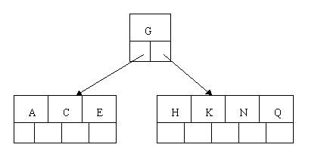
B Trees
C N G A H E K Q M F W L T Z D P R X Y S
Inserting E, K, and Q proceeds without requiring any splits:

Slide 26

B Trees
C N G A H E K Q M F W L T Z D P R X Y S
Insert M

Slide 27
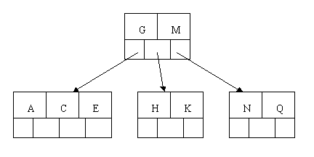
B Trees
C N G A H E K Q M F W L T Z D P R X Y S
Inserting M requires a split. Note that M happens to be the median key and so is moved up into the parent node.

Slide 28
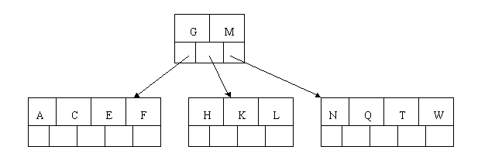
B Trees
C N G A H E K Q M F W L T Z D P R X Y S
The letters F, W, L, and T are then added without needing any split.

Slide 29
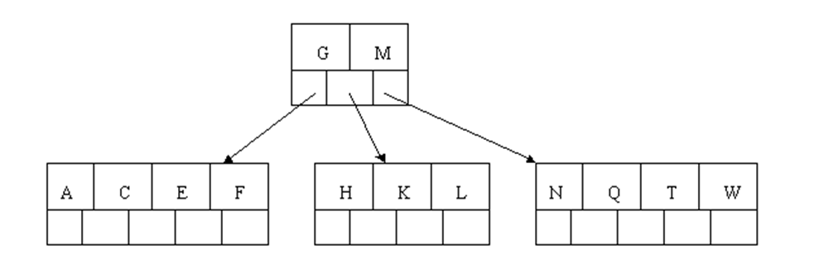
B Trees
C N G A H E K Q M F W L T Z D P R X Y S
Add Z

Slide 30
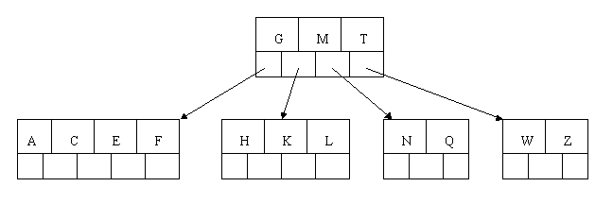
B Trees
C N G A H E K Q M F W L T Z D P R X Y S
When Z is added, the rightmost leaf must be split. The median item T is moved up into the parent node. Note that by moving up the median key, the tree is kept fairly balanced, with 2 keys in each of the resulting nodes.

Slide 31

B Trees
C N G A H E K Q M F W L T Z D P R X Y S
insert D

Slide 32
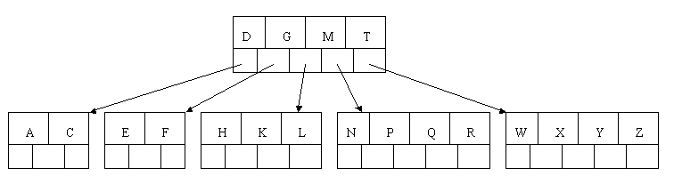
B Trees
C N G A H E K Q M F W L T Z D P R X Y S
The insertion of D causes the leftmost leaf to be split. D happens to be the median key and so is the one moved up into the parent node. The letters P, R, X, and Y are then added without any need of splitting:

Slide 33

B Trees
C N G A H E K Q M F W L T Z D P R X Y S
Add S

Slide 34
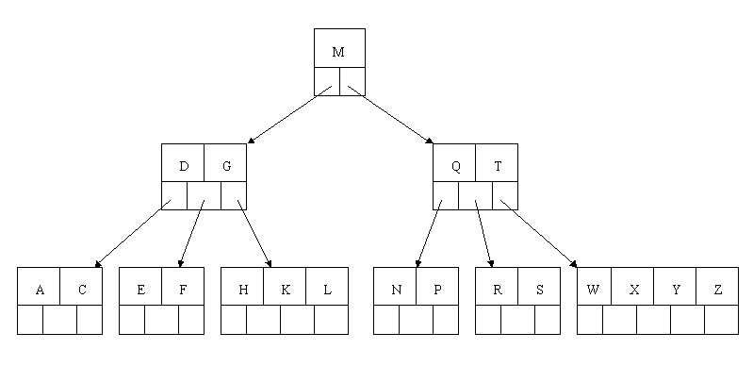
B Trees
C N G A H E K Q M F W L T Z D P R X Y S
when S is added, the node with N, P, Q, and R splits, sending the median Q up to the parent. The parent node is full, so it splits, sending the median M up to form a new root node.

Slide 35
B Trees
Delete H

Slide 36
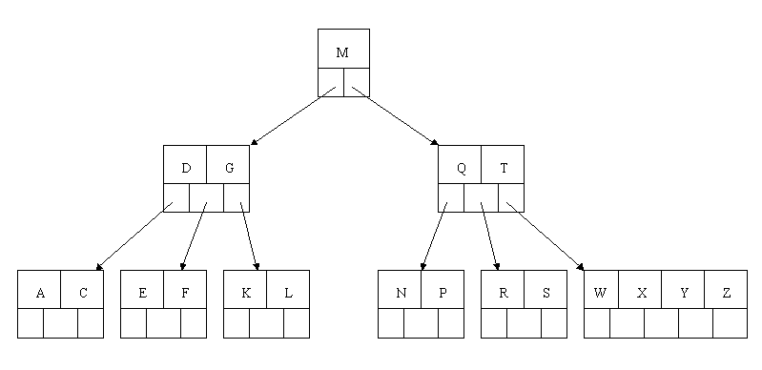
B Trees
Delete H

Slide 37
B Trees
Next, delete T.

Slide 38
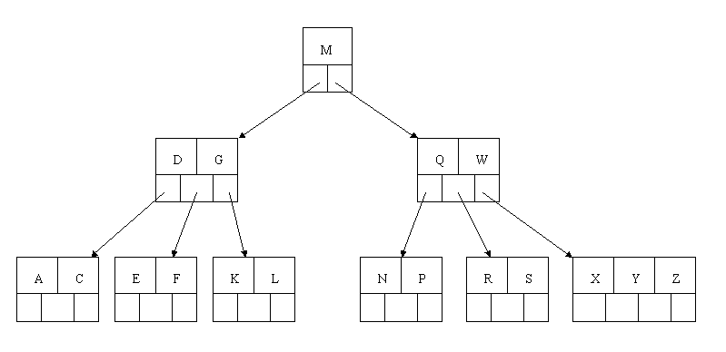
B Trees
Since T is not in a leaf, we find its successor (the next item in ascending order)
move W up to replace the T

Slide 39
B Trees
Next, delete R

Slide 40
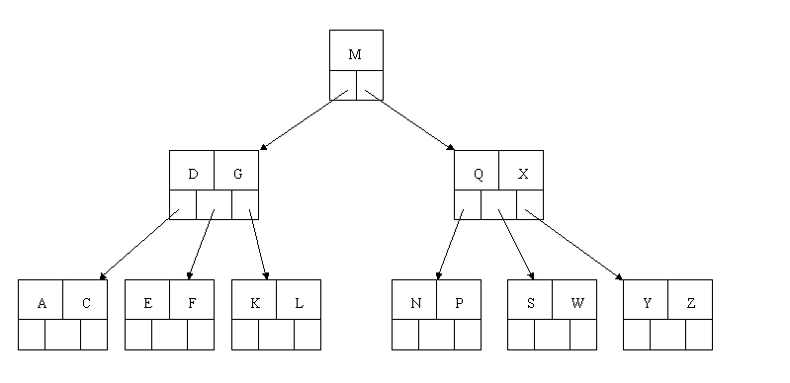
B Trees
Next, delete R - the deletion results in a node with only one key,
If the sibling node to the immediate left or right has an extra key, borrow a key from the parent and move a key up from this sibling.
the successor W of S is moved down, left key X of sibling moved up.

Slide 41
B Trees
Finally, delete E

Slide 42
B Trees
Finally, delete E
Although E is in a leaf, the leaf has no extra keys, nor do the siblings to the immediate right or left
the leaf has to be combined with one of these two siblings, move parent down (D)

Slide 43
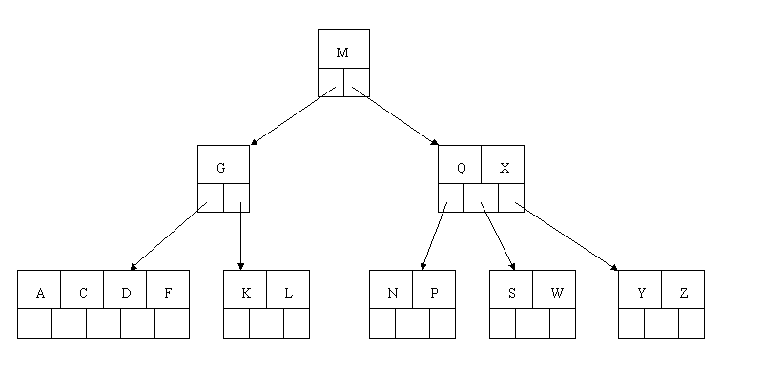
B Trees
Finally, delete E
Although E is in a leaf, the leaf has no extra keys, nor do the siblings to the immediate right or left
the leaf has to be combined with one of these two siblings, move parent down (D)

Slide 44
B Trees
the parent node now contains only one key, G
No left or right sibling to borrow key
Move M down ( Tree shrink by 1)

Slide 45
B Trees
the parent node now contains only one key, G

Slide 46
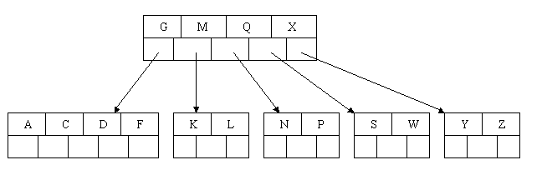
B Trees
the parent node now contains only one key, G
No left or right sibling to borrow key
Move M down ( Tree shrink by 1)

Slide 47
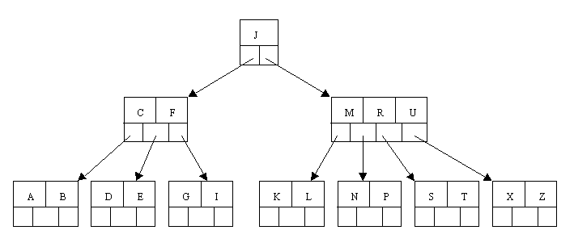
B Trees
Delete C

Slide 48
Delete c
Deleting C – find immediate Successor of - D
Move D up, to replace C

Slide 49
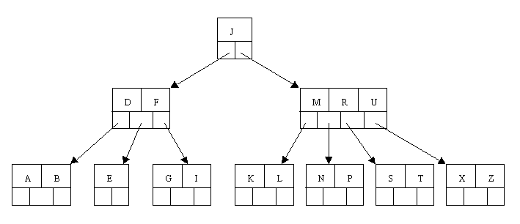
Delete c
Deleting C – Leaves Only E

Slide 50
Delete c
Deleting C – Leaves Only E – No sibling with spare key
Combine

Slide 51
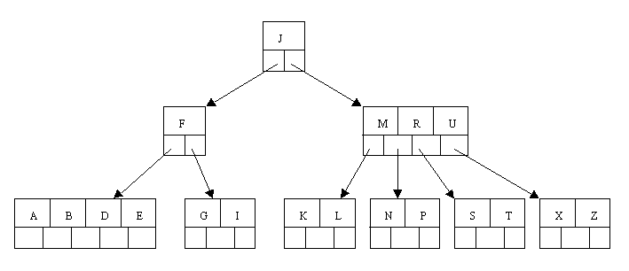
Delete c
Deleting C – consolidate with the A B node

Slide 52
Delete c
Deleting C – F has not enough keys

Slide 53
Delete c
Deleting C – F has not enough keys – borrow from sibling

Slide 54
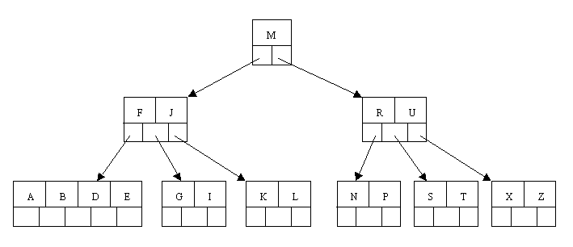
Delete c
Deleting C – F has not enough keys – borrow from sibling

Slide 55
Operations
B-Tree of order 4
  Each node has at most 4 pointers and 3 keys, and at least 2 pointers and 1 key.
Insert: 5, 3, 21, 9, 1, 13, 2, 7, 10, 12, 4, 8
Delete: 2, 21, 10, 3, 4

Slide 56
Insert 5, 3, 21
* 5 *
a
* 3 * 5 *
a
* 3 * 5 * 21 *
a

Slide 57
Insert 9
* 9 *
a
b
c
* 3 * 5 *
* 21 *
Node a splits creating 2 children: b and c

Slide 58
Insert 1, 13
* 9 *
a
b
c
* 1 * 3 * 5 *
* 13 * 21 *
Nodes b and c have room to insert more elements

Slide 59
Insert 2
* 3 * 9 *
a
b
d
c
* 1 * 2 *
* 5 *
* 13 * 21 *
Node b has no more room, so it splits creating node d.

Slide 60
Insert 7, 10
* 3 * 9 *
a
b
d
c
* 1 * 2 *
* 5 * 7 *
* 10 * 13 * 21 *
Nodes d and c have room to add more elements

Slide 61
Insert 12
* 3 * 9 * 13 *
a
b
d
c
e
* 1 * 2 *
* 5 * 7 *
* 10 * 12 *
* 21 *
Nodes c must split into nodes c and e

Slide 62
Insert 4
a
* 3 * 9 * 13 *
b
d
c
e
* 1 * 2 *
* 4 * 5 * 7 *
* 10 * 12 *
* 21 *
Node d has room for another element

Slide 63
Insert 8
a
* 9 *
f
g
* 3 * 7 *
* 13 *
b
d
h
c
e
* 1 * 2 *
* 4 * 5 *
* 8 *
* 10 * 12 *
* 21 *
Node d must split into 2 nodes. This causes node a to split into 2 nodes and the tree grows a level.

Slide 64
Delete 2
a
* 9 *
f
g
* 3 * 7 *
* 13 *
b
d
h
c
e
* 1 * 2 *
* 4 * 5 *
* 8 *
* 10 * 12 *
* 21 *
Node d must split into 2 nodes. This causes node a to split into 2 nodes and the tree grows a level.

Slide 65
Delete 2
* 9 *
a
f
g
* 3 * 7 *
* 13 *
b
d
h
c
e
* 1 *
* 4 * 5 *
* 8 *
* 10 * 12 *
* 21 *
Node b can loose an element without underflow.

Slide 66
Delete 21
* 9 *
a
f
g
* 3 * 7 *
* 13 *
b
d
h
c
e
* 1 *
* 4 * 5 *
* 8 *
* 10 * 12 *
* 21 *
.

Slide 67
Delete 21
* 9 *
a
f
g
* 3 * 7 *
* 13 *
b
d
h
c
e
* 1 *
* 4 * 5 *
* 8 *
* 10 * 12 *
.

Slide 68
Delete 21
* 9 *
a
f
g
* 3 * 7 *
* 12 *
b
d
h
c
e
* 1 *
* 4 * 5 *
* 8 *
* 10 *
* 13 *
Deleting 21 causes node e to underflow, so elements are redistributed between nodes c, g, and e

Slide 69
Delete 10
* 9 *
a
f
g
* 3 * 7 *
* 12 *
b
d
h
c
e
* 1 *
* 4 * 5 *
* 8 *
* 10 *
* 13 *

Slide 70
Delete 10
* 9 *
a
f
g
* 3 * 7 *
* 12 *
b
d
h
c
e
* 1 *
* 4 * 5 *
* 8 *
* 13 *

Slide 71
Delete 10
* 9 *
a
f
g
* 3 * 7 *
* *
b
d
h
c
e
* 1 *
* 4 * 5 *
* 8 *
*12 13 *

Slide 72
Delete 10
* 7 *
a
f
g
* 3 *
* 9 *
b
d
h
c
e
* 1 *
* 4 * 5 *
* 8 *
*12 13 *
Merge NULL and 13 nodes

Slide 73
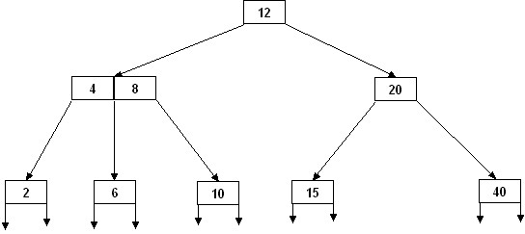
Deletion :
Example:
Delete the key 40 in the following B-tree of order 3:

Slide 74
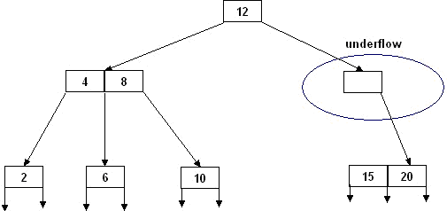
Deletion : Special Case, involves rotation and merging
Example:
Delete the key 40 in the following B-tree of order 3:
B-tree of order 5
merge 15 and 20

Slide 75
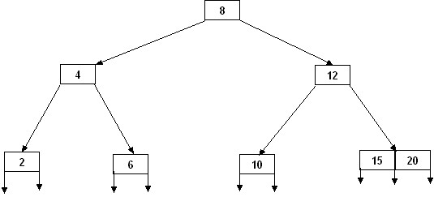
Deletion : Special Case, involves rotation and merging
Example:
Delete the key 40 in the following B-tree of order 3:
B-tree of order 5
merge 15 and 20
rotate 8 and its right subtree

Slide 76
Data Structure for B-Trees
typedef struct {
int Count; // number of keys stored in the current node
ItemType Key[3]; // array to hold the 3 keys long
Branch[4]; // array of pointers (record numbers)
} NodeType;

Slide 77
(2,4) Trees
A (2,4) tree (also called 2-4 tree or 2-3-4 tree) is a multi-way search with the following properties
  Node-Size Property: every internal node has at most four children
  Depth Property: all the external nodes have the same depth
Depending on the number of children, an internal node of a (2,4) tree is called a 2-node, 3-node or 4-node
10 15 24
2 8
12
18
27 32
(2,4) Trees

Slide 78
Height of a (2,4) Tree
Theorem: A (2,4) tree storing n items has height O(log n)
Proof:
  Let h be the height of a (2,4) tree with n items
  Since there are at least 2^{i} items at depth i = 0, … , h − 1 and no items at depth h, we have
  n ≥ 1 + 2 + 4 + … + 2^{h−1} = 2^{h} − 1
  Thus, h ≤ log (n + 1)
Searching in a (2,4) tree with n items takes O(log n) time
depth
items
0
1
1
2
h−1
2^{h−1}
h
0
(2,4) Trees

Slide 79
Analysis of Insertion
Algorithm put(k, o)
1. We search for key k to locate the insertion node v
2. We add the new entry (k, o) at node v
3. while overflow(v)
  if isRoot(v)
  create a new empty root above v
  v ← split(v)
Let T be a (2,4) tree with n items
  Tree T has O(log n) height
  Step 1 takes O(log n) time because we visit O(log n) nodes
  Step 2 takes O(1) time
  Step 3 takes O(log n) time because each split takes O(1) time and we perform O(log n) splits
Thus, an insertion in a (2,4) tree takes O(log n) time
(2,4) Trees

Slide 80
Analysis of Deletion
Let T be a (2,4) tree with n items
  Tree T has O(log n) height
In a deletion operation
  We visit O(log n) nodes to locate the node from which to delete the entry
  We handle an underflow with a series of O(log n) fusions, followed by at most one transfer
  Each fusion and transfer takes O(1) time
Thus, deleting an item from a (2,4) tree takes O(log n) time
(2,4) Trees

